Slide 1
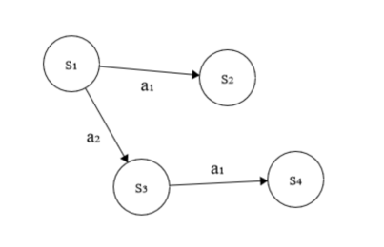
Replanning after encountering unexpected situations
Output Plan
Action 1
Action 2
…
Goal
Verify Game State
Plan Completed
Game State
Return plan to execute
Generate a plan from the game state
Planner
Select a goal state
Demonstration Actions
Potential Goal States
Selected Goal
Search for a plan

Slide 2
Final Plan
Observed States
Return plan if
isGoal(s’)
Mark state as observed
Obtain s’ from demonstration
transitions or use the predictor
(s,a,s’)
Demonstration
Data
(s, a, s’) ϵ T
Current State = s
s’ = ϕ(s,a)
Dequeue from KNOWN if it is non-empty. Otherwise dequeue from UNKNOWN
If s’ ϵ T and
s’ unobserved
If not s’ ϵ T
KNOWN
UNKNOWN

